Slide 1
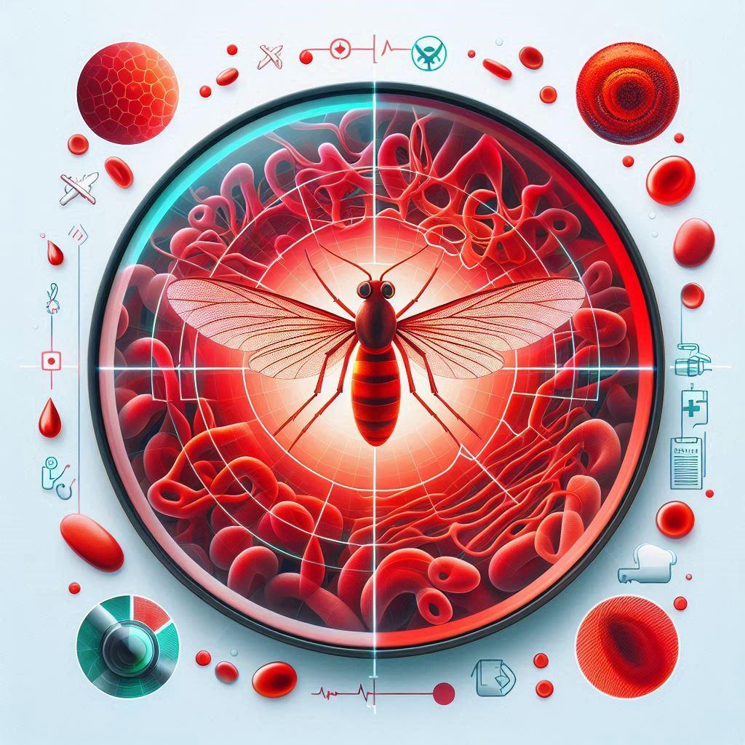



Deep Learning Computer Vision for Malaria Detection:
MalariaVision-AI
26 October 2025
Lori S. Cobb Kreisman
MIT Applied Data Sciences Certificate Program - Capstone Project

Slide 2

Malaria kills over 600,000 people annually, with 95% of deaths in sub-Saharan Africa—but the bottleneck isn't treatment, it's diagnosis.
The Global Malaria Diagnostic Challenge
Infrastructure gaps: Manual microscopy requires significant time of highly trained specialists who are scarce in rural endemic regions
Diagnostic errors: High inter-observer variability leads to missed or delayed detection
Impact: Limited diagnostic access → Preventable deaths Delayed or missed diagnosis → disease progression, continued transmission, continued disease spread
Key Takeaway: Fast, accurate, accessible diagnosis is the missing link in malaria elimination efforts.

Slide 3

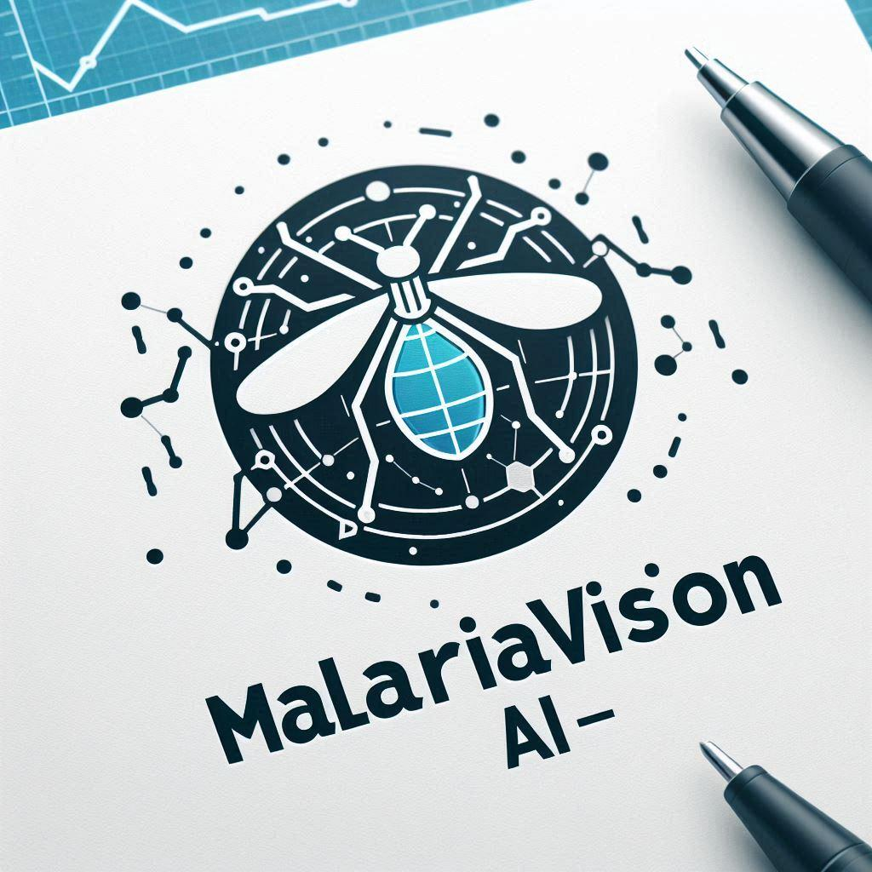
The solution
MalariaVision-AI
AI-Powered Diagnosis: Accessible, Fast, Accurate
The Approach: Automated deep learning computer vision to detect malaria-infected erythrocytes from standard blood smear images
Key Differentiator: Combines clinical workflow simplicity with cutting-edge AI—scalable to resource-limited settings

Slide 4
Roadmap to MalariaVision-AI Development
Technical Innovations:
Developed and compared 5 different CNN architectures
Models were trained on 24,958 images of infected erythrocytes
Selected model optimally balances accuracy, speed, and computational efficiency
Goal Achieved
All models were tested with 2,600 color test images
Accuracies achieved were 97.0-98.5%
Transfer Learning
Uses the pre-trained VGG16 model for the convolutional layers
Augmented BN LeakyReLU Model
Same architecture as model 3, but trained with image data augmentation to increase the diversity of the training data
CNN with Batch Normalization and Leaky ReLU
Adds batch normalization to each convolutional and dense layer, and replaces ReLU with Leaky ReLU
Deeper/Wider CNN
4 convolutional layers and 2 dense layers
Basic CNN
Sequential model with 3 convolutional layers and 1 dense layer

Slide 5

Data Analysis: Comparison of CNN Models
Model | Global Accuracy | Infected Precision | Infected Recall | Infected F1-Score | Uninfected Precision | Uninfected Recall | Uninfected F1-Score
Model 1 | 0.981154 | 0.983759 | 0.978462 | 0.981103 | 0.978577 | 0.983846 | 0.981204
Model 2 | 0.980000 | 0.969880 | 0.990769 | 0.980213 | 0.990566 | 0.969231 | 0.979782
Model 3 | 0.983846 | 0.982362 | 0.985385 | 0.983871 | 0.985340 | 0.982308 | 0.983821
AugBN LReLU Model | 0.996151 | 0.998064 | 0.989231 | 0.984085 | 0.981481 | 0.980700 | 0.989374
VGG16 Model | 0.972308 | 0.974498 | 0.970000 | 0.972244 | 0.970138 | 0.974615 | 0.972371

Slide 6
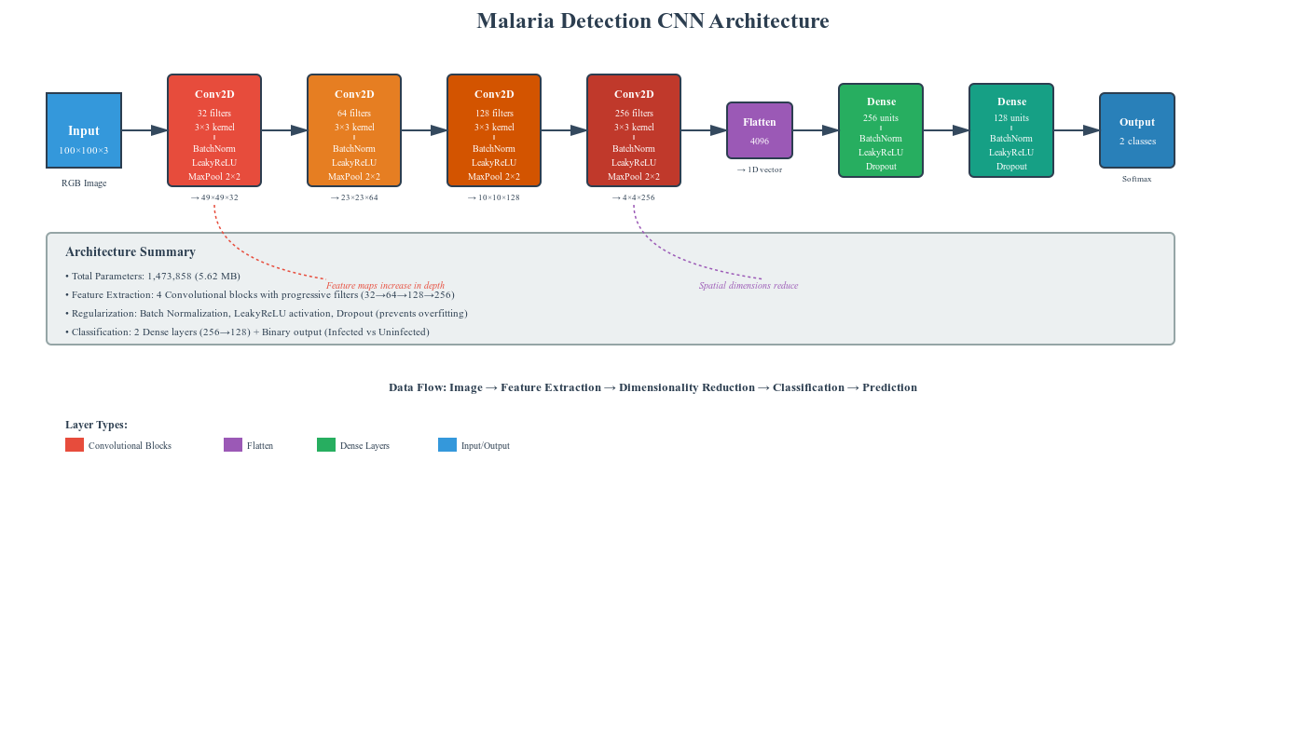
Architecture of the Successful Model
Augmented data with batch normalization and Leaky ReLu

Slide 7
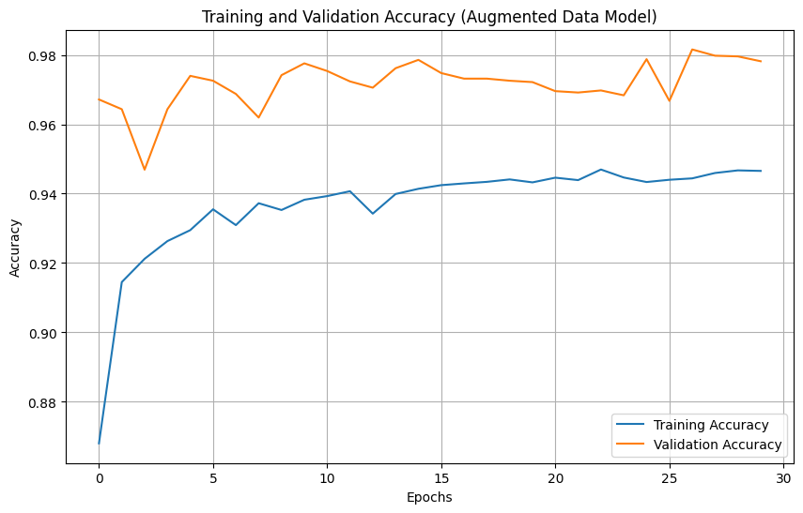
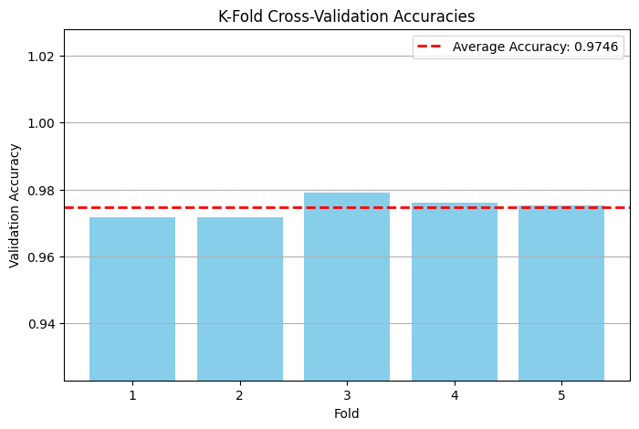
Data Analysis: Analysis of MalariaVision-AI
Analysis of training on a single training/validation split of the input data
Average validation accuracy was 0.9846 and test loss was 0.0491
Analysis of K-Fold Cross-Validation
Provides a more robust estimate of the model's performance and its ability to generalize compared to a single train/validation split
Average validation accuracy is 0.9734 and validation loss is approximately 0.0888

Slide 8

Diagnostic Workflow for Clinical Implementation
Model Input Preparation
Sample Collection
Cellular Staining
Microscopy and Image Capture
Image Preprocessing
Venous blood draw from patient
Blood smear preparation on glass slide
Giemsa stain (standard for malaria)
Stains parasites purple/blue
Red blood cells appear pink
100× oil immersion lens
High-resolution image using camera or smartphone adapter on microscope
Resize to neural network model input size: 100×100 pixels
Normalization: Scale pixel values to 0-1 range
Divide by 255 (if RGB values are 0-255)
Format conversion if needed to ensure RGB 3 channels maintained
Load image into array format
Convert to numpy array
Add batch dimension
Ensure correct data type
Run through computer vision model

Slide 9
Expected Benefits
For Hospitals:
Increased diagnostic capacity: 10-20× more patients diagnosed per day with same staffing.
Cost reduction: Eliminate need for specialized microscopists
Improved accuracy: Reduce diagnostic error rate from 20-30% to <5%
Faster turnaround: Results in seconds vs. 30-120 minutes per sample
For Patients:
Faster treatment: Same-day diagnosis and treatment initiation
Reduced mortality: Early detection prevents progression to severe/cerebral malaria
Better access: Diagnostic capability to reach remote, underserved populations
For Public Health:
Disease surveillance: Real-time tracking of case patterns and outbreaks.
Progress towards elimination: Accelerated detection supports malaria elimination goals.
Cost Savings
Savings per diagnosis: US$13.60-29.40
Annual savings per clinic: US$68k-147k (at 5,000 diagnoses/year)

Slide 10
Business Recommendations
MalariaVision-AI removes a significant diagnostic barrier to life-saving treatment
Requires minimal additional infrastructure (internet and camera) and integrates seamlessly into existing clinical workflows
Results in significant cost savings over traditional diagnosis methodologies
Scales to remote settings
MalariaVision-AI will democratize access to accurate, rapid malaria diagnosis and accelerate progress towards malaria elimination in endemic regions

Slide 11
Steps Needed for Implementation
Technical Development:
Deploy model to cloud/server infrastructure with secure API
Develop user-friendly interface (mobile app or web portal)
Implement patient data security and privacy protections
Regulatory & Clinical Validation:
Complete prospective clinical trials in real-world settings
Obtain regulatory approval (FDA, or local equivalents)
Establish quality assurance and monitoring protocols
Deployment & Training:
Pilot implementation at select healthcare facilities
Build partnerships with local and global health organizations
Complete prospective clinical trials in real-world settings

Slide 12
Thank you

